Slide 1





TextEvolve
Digitizing History with AI/OCR
Team Name
:
Dynamic Dreamers
NMNT ID
:
NMNTSTD7116020
College Name
:
Kathir College of Engineering

Slide 2
Introduction & Background
Overview:
Historical documents are invaluable cultural assets.
Many such documents are handwritten and exist in regional languages, making them hard to access.
Purpose:
To preserve cultural heritage by converting these documents into accessible digital formats.
Context:
Growing demand for digitization in libraries, museums, and academic research.

Slide 3
Problem Statement
Theme:
Artificial Intelligence
Problem Statement:
How might we develop an AI or OCR solution to digitize and convert handwritten, old registered documents into a readable and accessible format in regional languages, improving public access and readability of historical records? The solution should allow the output to be downloaded in various formats such as PDF and Word, enabling wider distribution and accessibility.

Slide 4
Challenges
Degradation:
Physical documents deteriorate over time.
Inaccessibility:
Limited access to rare or regional texts.
Handwriting Variability:
Handwritten texts present difficulties in standard OCR processing.
Language Barriers:
Many OCR solutions are not optimized for regional languages.

Slide 5
Our Solution – TextEVolve
What is TextEvolve?
An AI-driven platform combining a custom ML model with the OCR API for high-accuracy text recognition.
Key Points:
Tailored for historical and handwritten documents.
Supports multiple regional languages.
Provides a user-friendly interface for both upload and retrieval.

Slide 6
Key Features
Advanced OCR Conversion:
Utilizes a bespoke ML model for recognizing diverse handwriting styles.
Integrates with Google OCR API for enhanced accuracy.
Multi-Language Support:
Designed to handle various regional scripts and languages.
User-Friendly Interface:
Built with React Vite and Tailwind for fast, responsive interactions.
Robust Data Handling:
Python Flask backend paired with MongoDB ensures scalable and secure storage.

Slide 7



















Technology Stack
Programming Languages
Database & Deployment
Frameworks & Libraries
Development Tools

Slide 8




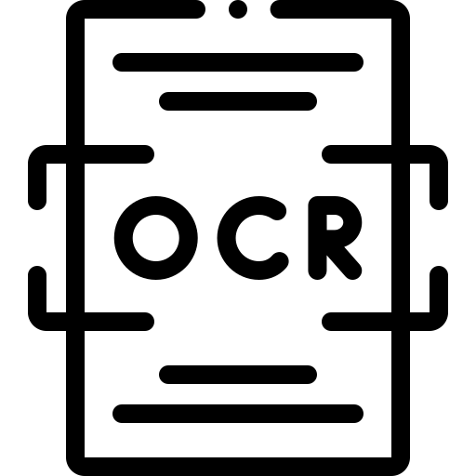
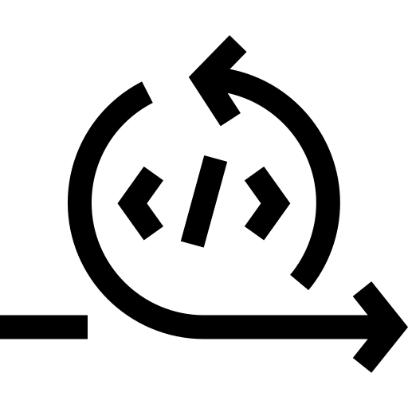






System Architecture & Workflow
Model initial conversion
User Access
Save successful?
Data Ingestion
Preprocessing
OCR Conversion
Re-run ML model
Post-Processing
Storage
Results
Error
OCR API
Notify error

Slide 9

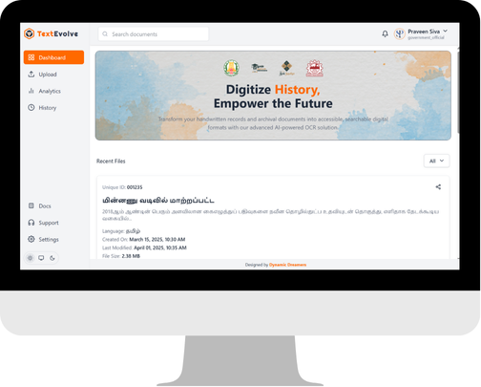
Demo / Sample Results
https://squadofcreators.github.io/TextEvolve

Slide 10
Benefits & Impact
Cultural Preservation: Safeguard historical documents for future generations.
Enhanced Accessibility: Allow researchers, educators, and the public to easily access digitized content.
Improved Research: Facilitate the study of regional languages and historical texts.
Scalability: A robust system that can grow to handle vast archives.

Slide 11
Conclusion
TextEVolve combines cutting-edge OCR technology with a user-friendly interface to transform historical documents.
The project ensures that our cultural heritage is preserved digitally.

Slide 12
Q&A
?
Ask Questions

Slide 13

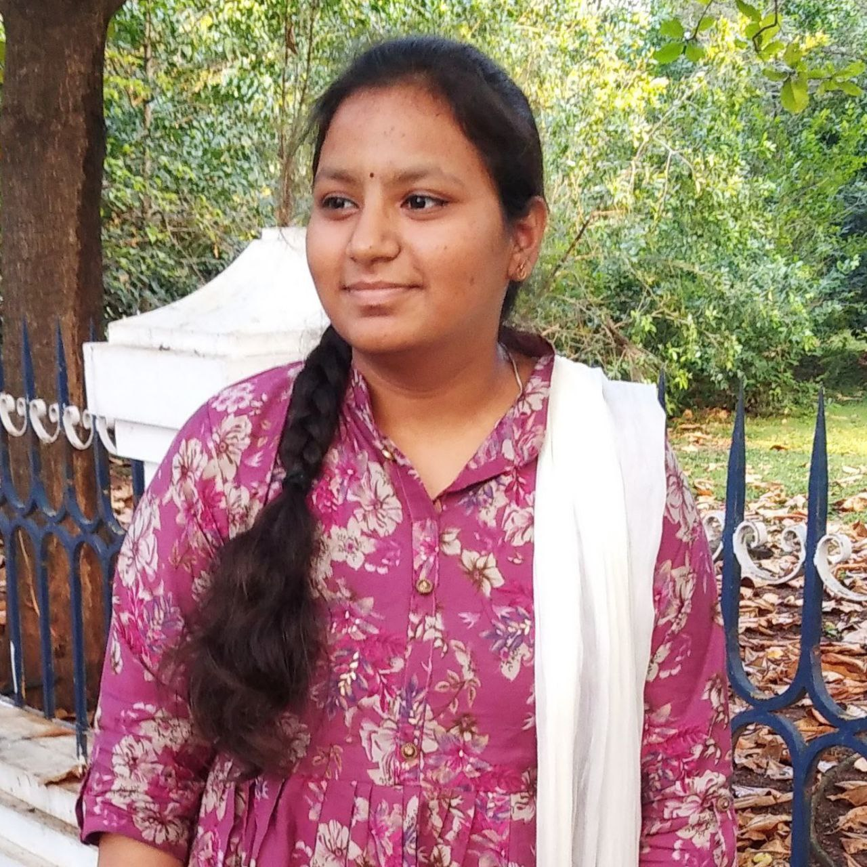



Our Team
Mrs. Kavitha M
Yuva Nandhini M
Faculty Guide
AI/ML Developer
Praveenkumar S
Sibi Siddharth S
Uma Maheswari P
AI/MERN Developer
AI/MERN Developer
AI/ML Developer

Slide 14
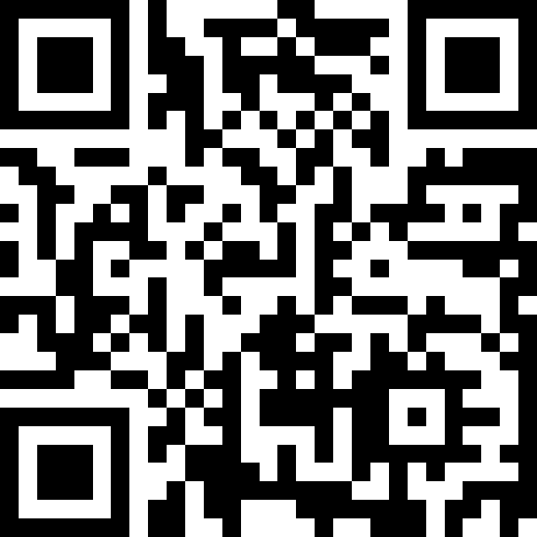
Live Project
Preserving the Past, Empowering the Future

